Slide 1

Single-axis
Tracker
0° N
270° W
90° E
Rotation
axis
180° S
Azimuth = 180°

Slide 2
180° S
0° N
Axis azimuth = 180° S
Rotation
axis
Flat:
Axis tilt = 0°
Rotation
axis
Axis azimuth = 180° S
Axis tilt = 5°
Sloping down to the South:
Axis azimuth = 0° N
Rotation
axis
Axis tilt = 5°
Sloping down to the North
(two options):
or
Axis azimuth = 180° S
Rotation
axis
Axis tilt = -5°

Slide 3
270° W
90° E
Horizontal
-45°
+45°
Max rotation angle = 45°

Slide 4
Fixed-tilt
0° N
270° W
90° E
180° S
Azimuth = 180°

Slide 5
Top-down view of 3P system (2 rows)
Course 3
Course 2
Course 1
End view of 3P system (2 rows)
Course 3
Course 2
Course 1
Shaded Fraction
Shade

Slide 6
180° S
0° N
Azimuth = 180° S
Length of side
Tilt = 20°
Pitch

Slide 7
True-tracking
Self-shade
Shade

Slide 8
Backtracking
Shade

Slide 9
Ground Coverage Ratio
L
P

Slide 10
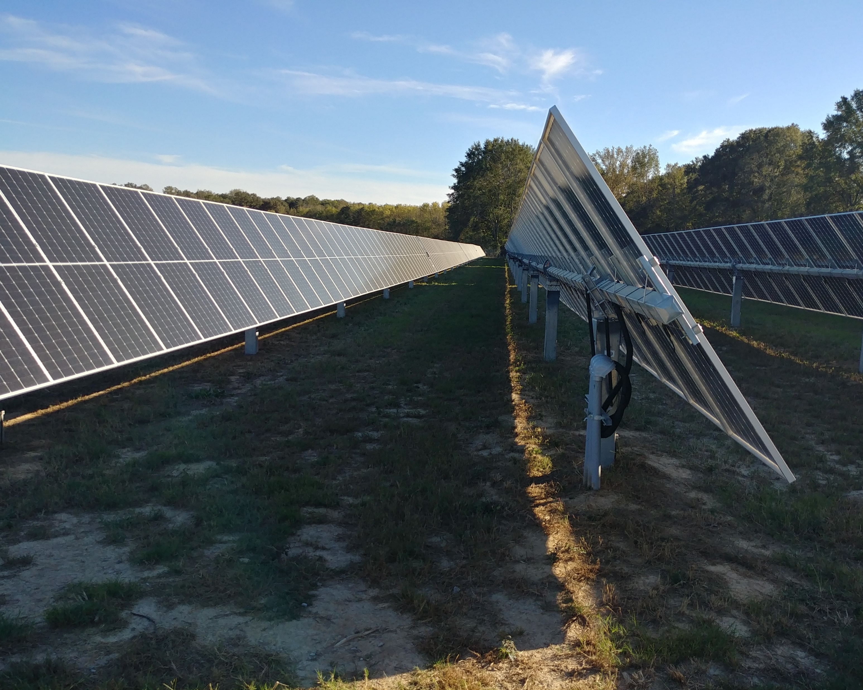

Slide 11
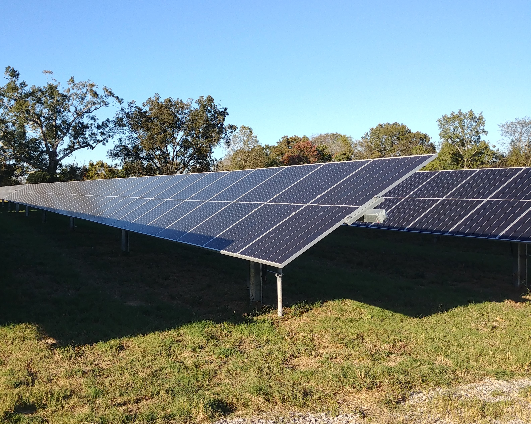

Slide 12
Old stuff

Slide 13
North: 0°
West:
270°
East:
90°
South: 180°
0° N
North: 0°
270° W
90° E
West: 270°
East: 90°
180° S
South: 180°

Slide 14
True-tracking
POA
sensor
Self-shade
Shade

Slide 15
Backtracking
POA
sensor
Shade

Slide 16
180° S
0° N
Axis azimuth = 180° S
Rotation
axis
Axis tilt = 0°
Rotation
axis
Axis azimuth = 180° S
Axis tilt = 5°
Axis azimuth = 0° N
Rotation
axis
Axis tilt = 5°

Slide 17
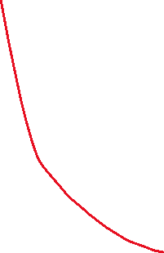

180° S
0° N
Axis azimuth = 180° S
Rotation
axis
[alternate…]
Axis tilt = 0°
Rotation
axis
Axis azimuth = 180° S
Axis tilt = 5°
Axis azimuth = 180° S
Rotation
axis
Axis tilt = -5°

